Slide 1

Starting HH Interviews in CAPI
Interviewers

Slide 2
Starting the Household Interview

Slide 3
What? Why? When? Who? How?
What?
Why?
When?
Who?
Where?
Beginning a household interview using CAPI menus
Simplicity and organization of work
After being assigned a household and locating it
Interviewers
In the households of respondents
Notes:
Note that supervisors can act as interviewers at any time

Slide 4




Steps to starting a HH interview
Locate desktop icon and open CAPI system
Choose household to interview
Choose “result” of interview and administer consent
Begin interview!

Slide 5
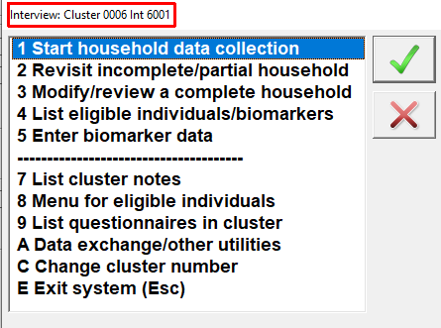
Open DHS CAPI system
Carefully check information
Notes:
The first time you open the menu system, you will enter the interviewer number, supervisor number, and cluster number.
After the first time, when the interviewer opens the menu system, the system will remember the interviewer, supervisor, and cluster number from the last time the system was used. The interviewer should double check that the intended cluster, interviewer, and supervisor number is correct (as seen in the second image in the red square).

Slide 6
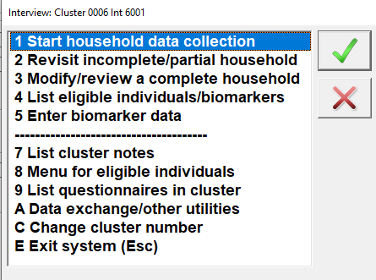
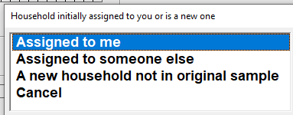
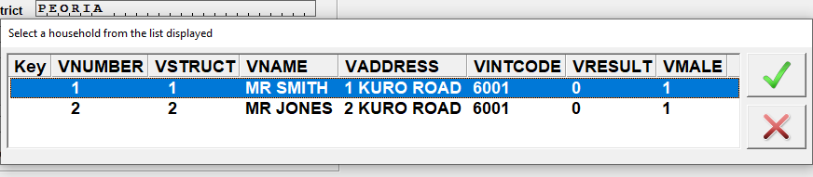
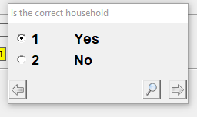
Steps to begin household interview

Slide 7
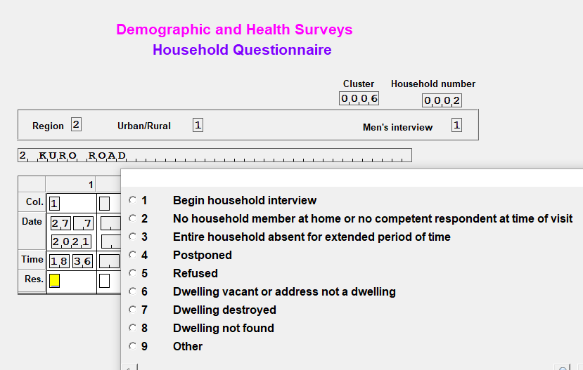
Complete cover page
All automatically populated
Notes:
All this information because automatically populated from a file that has all the information about the households that was collected during the household listing.

Slide 8
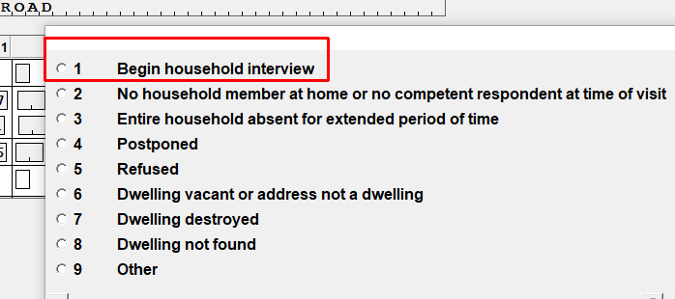
Complete cover page
Enter the “result” of the visit.
To begin an interview, use code 1
Notes:
Review of HH result codes from paper training… Choose (1) to begin the interview
ASK – what code if nobody is home? If nobody home, choose (2)
ASK – what code if you will make a call back? If making an appointment, choose (4)

Slide 9
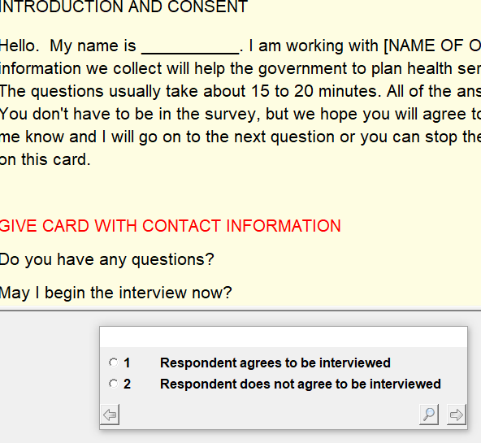
Complete cover page
Read consent statement and enter result of consent
Notes:
The consent statement must be read exactly as it is written
Discuss difference between this field and result code entered previously

Slide 10
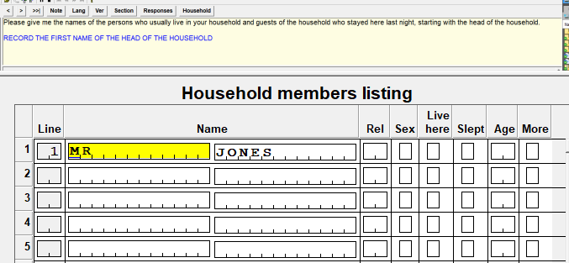
Begin HH interview!
Questions, instructions
Fields for data entry
Black – read out loud respondent
BLUE – instructions for interviewer
Red – actions for interviewer

Slide 11
Key aspects of the CAPI interview system
Data capture screen
Toolbar
Different types of questions
Error messages
Changing interview language
Taking Notes
Moving around the questionnaire
Partial save
Notes:
This is just a summary of the next section, each topic will be addressed in more depth in the following slides

Slide 12
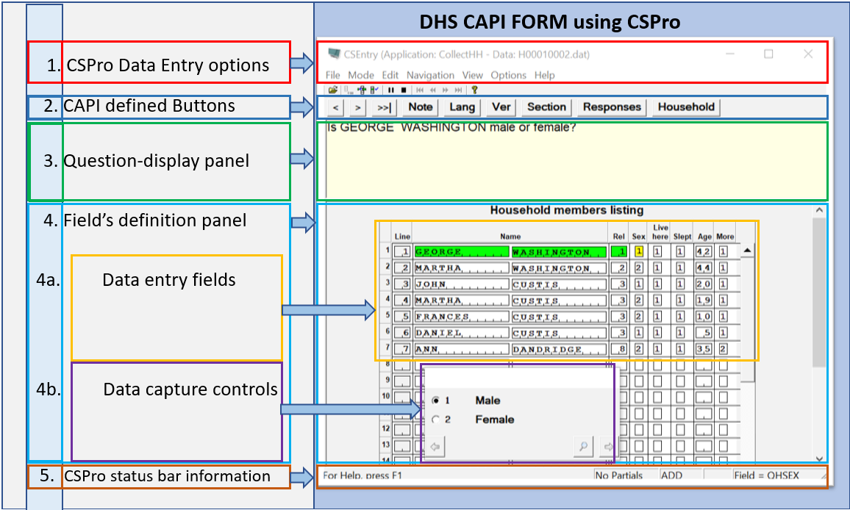
Data Capture Screen
Notes:
1 - CAPI defined Buttons 2 - Area for questions 3 - Data capture controls
4 - Fields definition area 5 - Error messages 6 - CSPro status bar information

Slide 13



Toolbar
 | Moves the cursor one field back. The button is also known as the “Back button”.
 | Moves cursor one field forward. The button is also known as the “Advance button”.
 | Moves to the end of the questionnaire or the last field where information has been already entered
 | Displays a window where interviewers can take notes related to the question where the cursor is placed

Slide 14
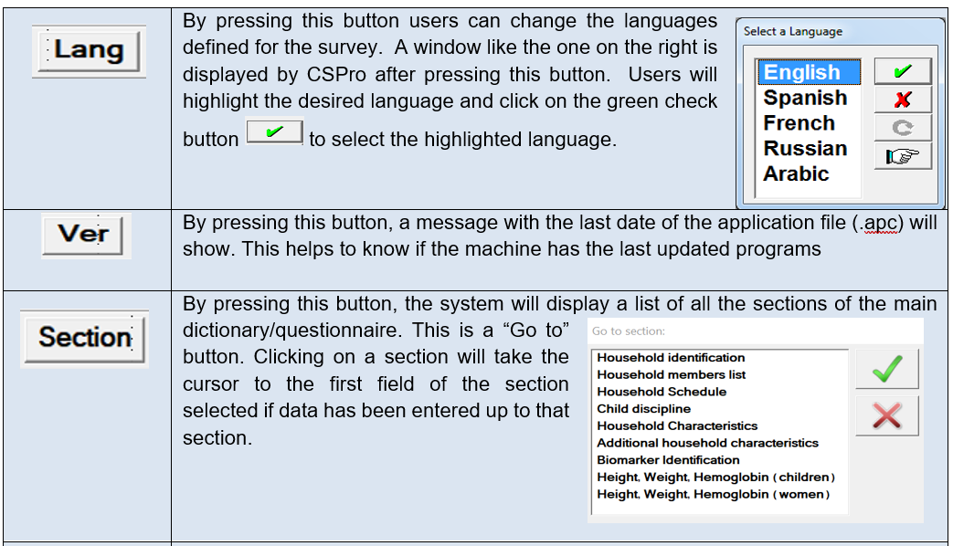
Toolbar

Slide 15
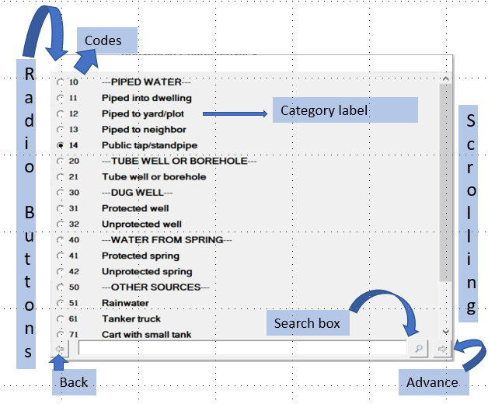
Controls Used to Input Data
Radio Buttons - for questions where only one response can be selected.
Notes:
There is a predefined number of responses (categories) with labels to the question
Sometimes there is scroll bar on the right side of the window

Slide 16
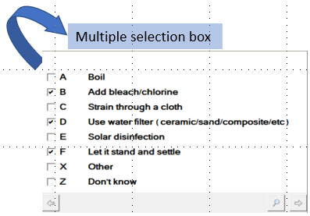
Multiple answers: Check boxes
For questions where more than one response can be selected
Responses for these questions use letter codes rather than numbers
Notes:
There is a predefined number of responses (categories) with labels to the question
Sometimes there is scroll bar on the right side of the window

Slide 17
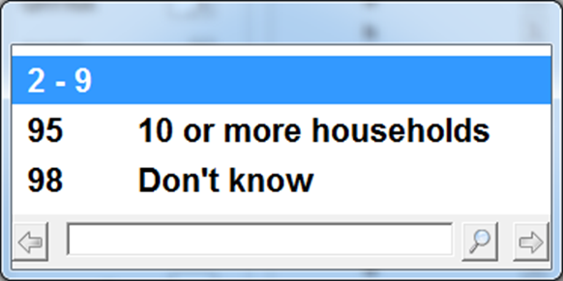
Controls Used to Input Numeric Data
Ranges of values – Only one value within the valid ranges (if within the range type)
Do not click on the range element, this will result in the lower value of the range being entered
Some questions may have special coded responses eg 98: Don’t know
Coded responses may be entered by clicking on the response or by entering the numeric code
Text Boxes – Names, addresses, other answers
Notes:
Ranges of values: The number of possible values for a question is too many to be displayed as a radio button (ages, size of land, income, etc.).

Slide 18
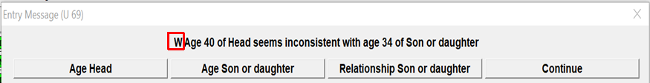
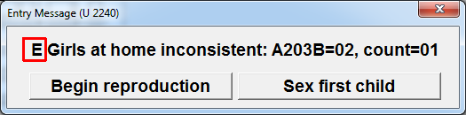
Error Messages
Warning message will allow to continue (note ‘W’ letter)
Error message requires correction before continuing (note ‘E’ letter)
Notes:
First type: The error provides buttons to return to two or more of the intervening questions that cause the error. It is a warning and by pressing “Continue” button, it allows to continue with the next applicable question.
Second type: The error provides buttons to return to two or more of the intervening questions that cause the error

Slide 19
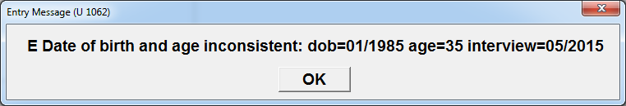
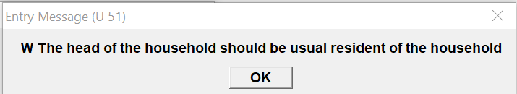
Error Messages
One option, problem has to be resolved
One option, allows to continue
Notes:
E-error type: Error is critical to the data integrity and as result it need to be corrected
W-error type: Error is not critical to the data integrity, but needs absolute attention before dismissing

Slide 20

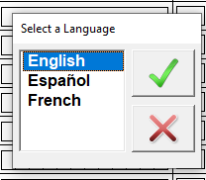
Changing language of the interview
Click on ‘Lang’ button in toolbar, then select desired language
Language can be changed at any time during the interview
A default language may be set by the system depending on team
Notes:
E-error type: Error is critical to the data integrity and as result it need to be corrected
W-error type: Error is not critical to the data integrity, but needs absolute attention before dismissing

Slide 21

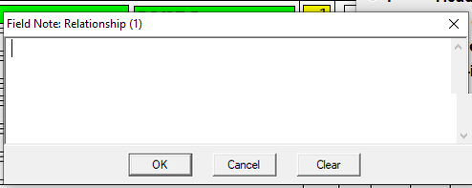
Taking Notes
Click on ‘Note’ button in toolbar
Note will be associated with the current question
Type text to record note and then click “Ok” to continue
Notes:
E-error type: Error is critical to the data integrity and as result it need to be corrected
W-error type: Error is not critical to the data integrity, but needs absolute attention before dismissing

Slide 22

Moving around the questionnaire
TOOLBAR NAVIGATION BUTTONS
 | Moves the cursor one field back. The button is also known as the “Back button”. Can also use keyboard SHIFT+TAB
 | Moves cursor one field forward. The button is also known as the “Advance button”. Can also use keyboard TAB or ENTER keys.
 | Moves to the end of the questionnaire or the last field where information has been already entered. Can also use F10 function key on keyboard.

Slide 23

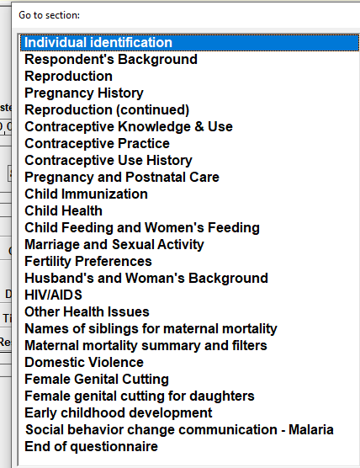
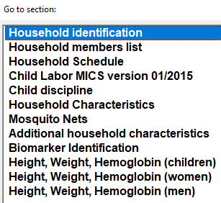
Moving around the questionnaire: Section List
Click on the section to which you wish to move
Note that you cannot move to a section that has not yet been entered
Household
Individual
Notes:
Note that the screen shots may need to be adapted so that the sections shown correspond to the country questionnaire

Slide 24
Partial save of interview
CAPI system automatically saves data at the end of each form/section
Sometimes interviewer may need to stop interview before it is completed and come back later
Use Partial Save feature to save data and come back later

Slide 25
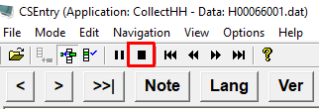

Steps for partial save of interview
1. Click on “Stop” button above toolbar
2. Select “Partial Save” at prompt

Slide 26

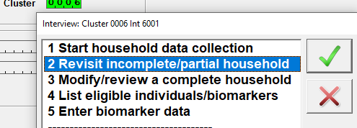
Partial save of interview
Use option 2: Revisit from interviewer menu to return to a partially saved interview

Slide 27
Household listing asked in three parts
1. Names of household members
Repeats for each person in the household
Questions asked: Name, relationship, sex, usual resident, slept in the household the night before, age in years
2. Group of single questions
- record line number of respondent to household questionnaire
- probe questions 2A, 2B, 2C for additional household members
3. Household Schedule – questions 8 – 15C repeated for each member

Slide 28
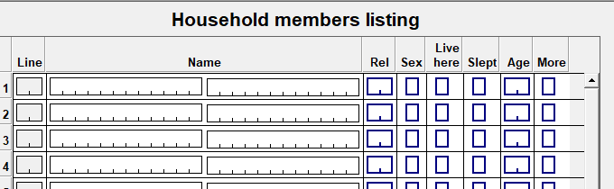
Names of household members
Ask name, relationship, sex, usual resident, slept in the household the night before, age in years
At end of each set of questions there is a question “Are there any other persons living in this household?”
If answer is yes, CAPI system will add an entry for another household member and repeat the set of questions

Slide 29
Probe questions for additional household members
After all household members have been identified…
We ask three probing questions to check that all individuals have been included
02A Small Children:
02B Non-family members:
02C Guests or temporary visitors:
If answer to any of these questions is “Yes”
Entry will return to the last question “Are there any other persons living in this household?” for last member listed
Change the response from “No” to “Yes”.
Program will then move to a new line for the additional household member.
Ask the questions presented by the system for that member.
Repeat this process for all additional members mentioned by the respondent.
Once all additional members entered, program will return to 02A-C.
You must change the “Yes” response given for 02A, B or C to “No” to continue

Slide 30
Exercise : Household questionnaire
Make sure all interviewers received assigned households from previous exercise
Use menu options 1. Start Household -> Assigned to me
Use cluster number 0001
Use the first household assigned to you and write down the household number – we will need to come back to it
Follow the mock interview and enter information carefully as it is given by the respondent

